Slide 1

Volunteering calendar 2026

Slide 2
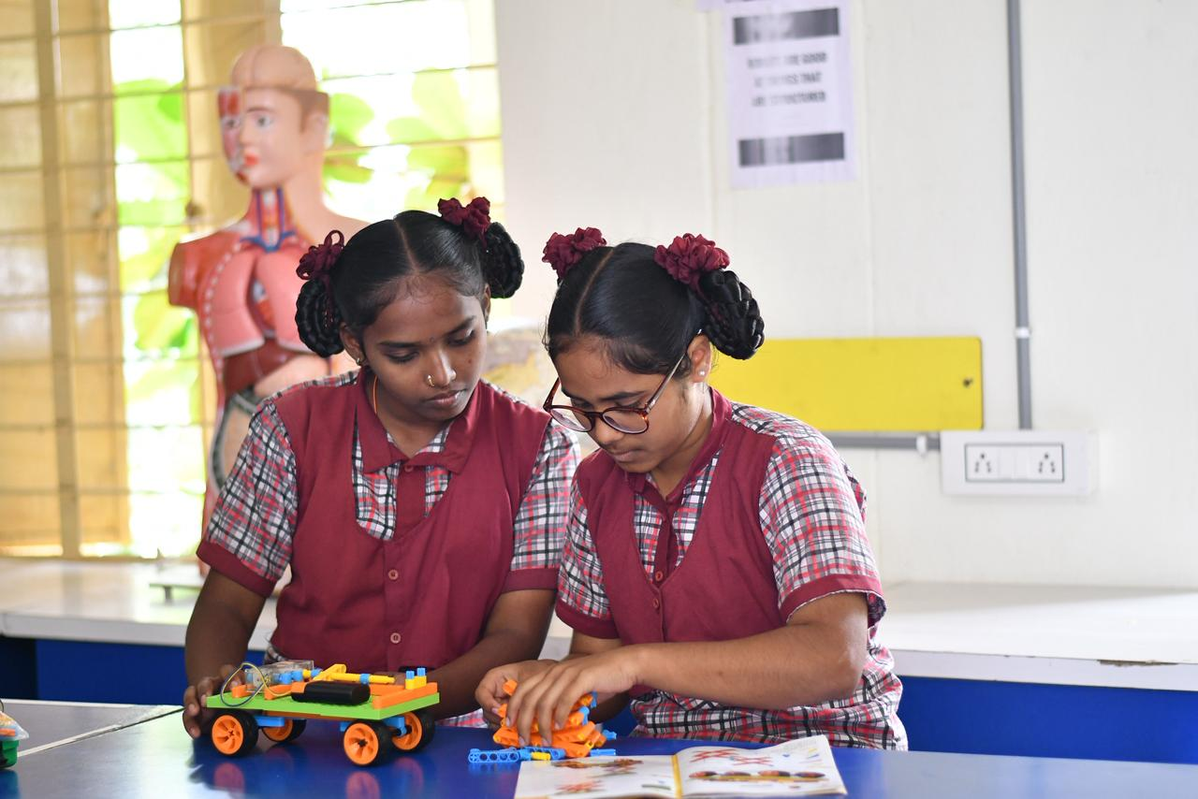
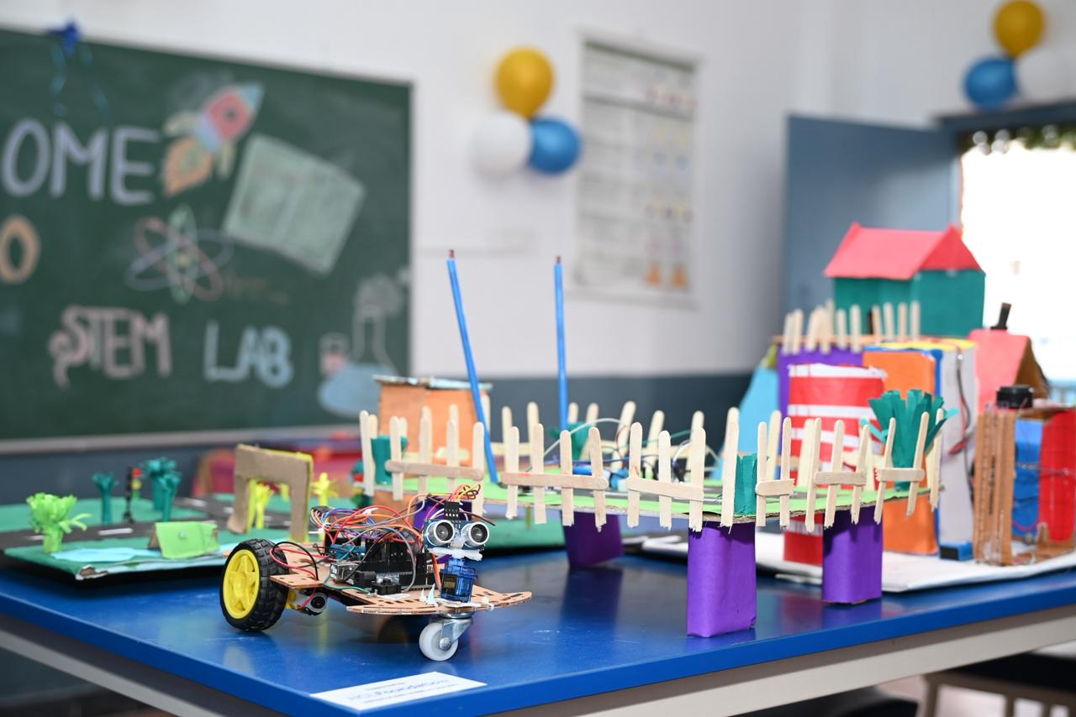
Education
Empowering Minds. Enabling Futures.
Objective:
Enable volunteers to support learning, curiosity, and future readiness among children and youth, especially from underserved communities.
Activities in this category focus on foundational learning, STEM exposure, reading habits, career awareness, and life skills through engaging, hands-on formats.
13+
Activities
50-100+
Employee Participation
80-200+
Impact (Students)
2-4
Estimated Efforts (hours)
Top Volunteering Activities
STEM Demo Day using low-cost experiments
Reading Habit Drive in Government Schools
Create STEAM Kits to Spark Curiosity
Career Readiness Kits for Underserved Youth
Avg. Budget: ₹ 17,000 - 35,000 / Activity
Note: Budget varies as per the activity, participants and duration

Slide 3
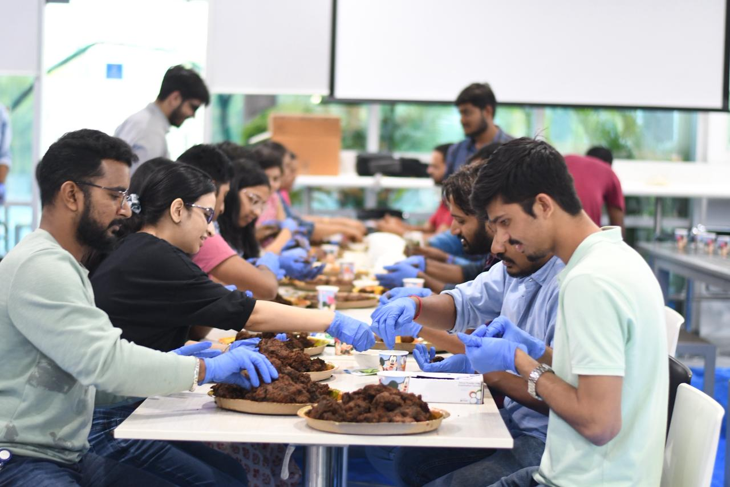
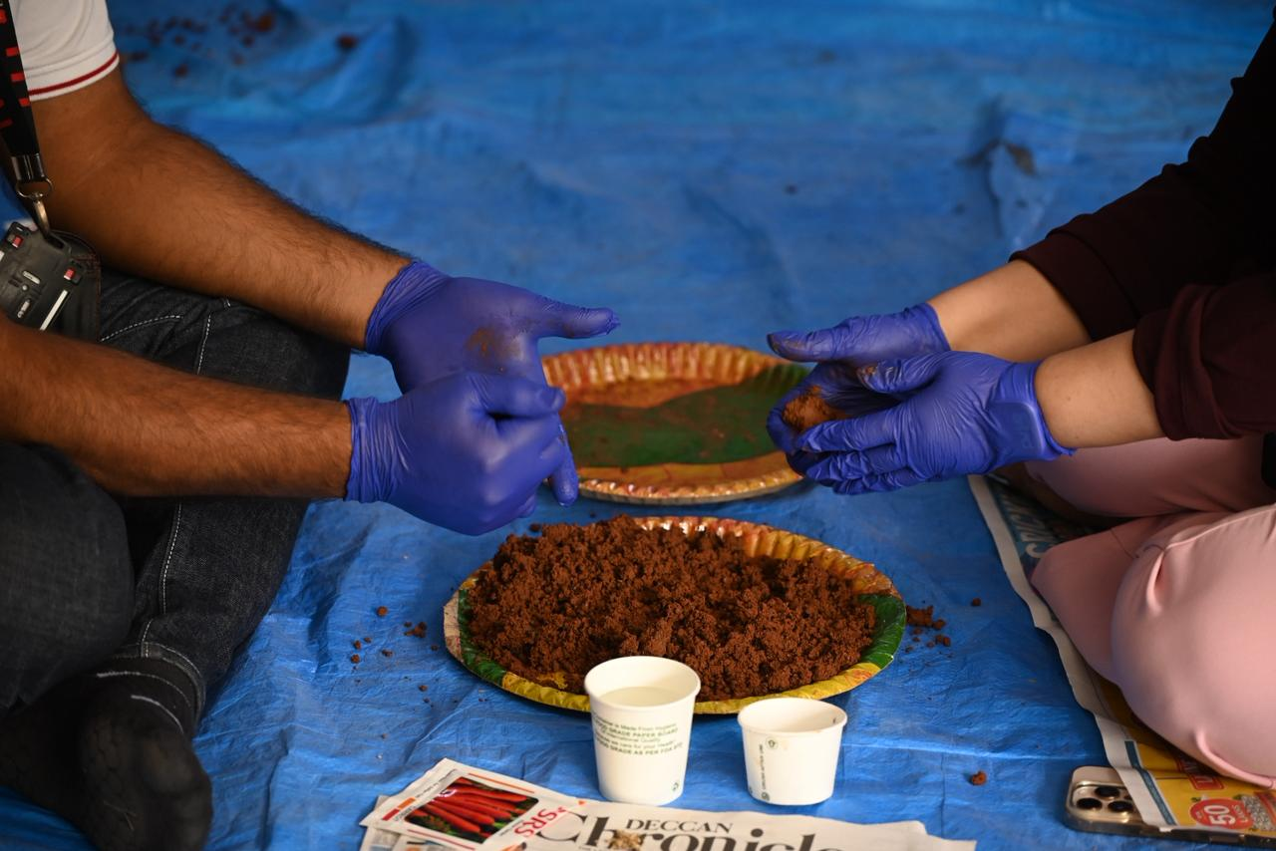
Environment & Sustainability
Small Actions. Big Environmental Impact
Objective:
Enable employees to actively contribute to climate action, waste reduction, biodiversity, and sustainable living.
This category includes hands-on outdoor drives and awareness-based initiatives, suitable for large and small employee groups alike.
25+
Activities
40-80+
Employee Participation
Impact: Community-level & environmental outcomes
2-4
Estimated Efforts (hours)
Top Volunteering Activities
Beach / Community Clean-up Drive
Seed Ball Making, Miyawaki forest & Plantation Activities
Waste Segregation & Plastic-Free Awareness
Urban Gardening / Micro-Greens Workshop
Budget: ₹ 20,000 - 40,000 / Activity
Note: Budget varies as per the activity, participants and duration

Slide 4
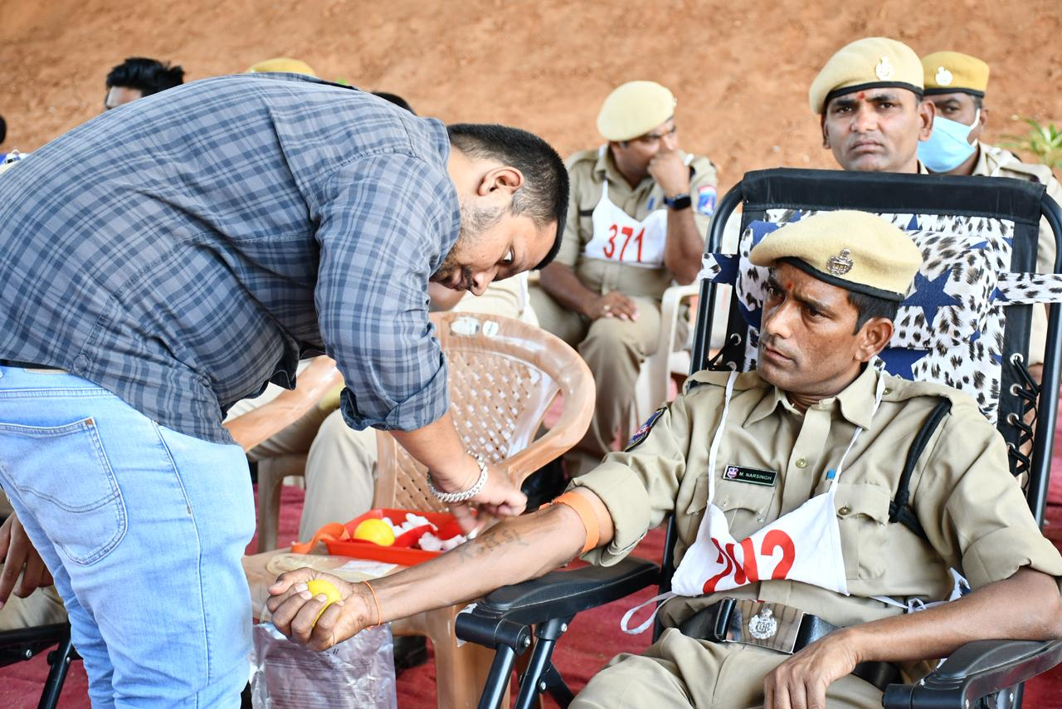
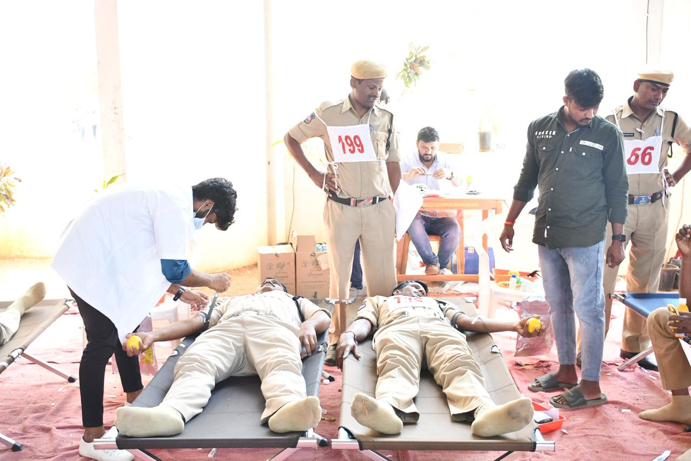
Health & Wellbeing
Health Awareness Today. Stronger Communities Tomorrow
Objective:
Support physical, mental, and emotional wellbeing through preventive healthcare awareness and compassionate engagement.
Activities range from health education sessions to comfort-focused volunteering for vulnerable groups.
25+
Activities
20-60+
Employee Participation
50-150+
Impact (Students)
2-3
Estimated Efforts (hours)
Top Volunteering Activities
Mental Health Awareness Session
First Aid & Lifestyle Disease Prevention
Comfort Kits for Children Undergoing Treatment
Blood Donation Camp
Budget: ₹ 20,000 - 70,000 / Activity
Note: Budget varies as per the activity, participants and duration

Slide 5
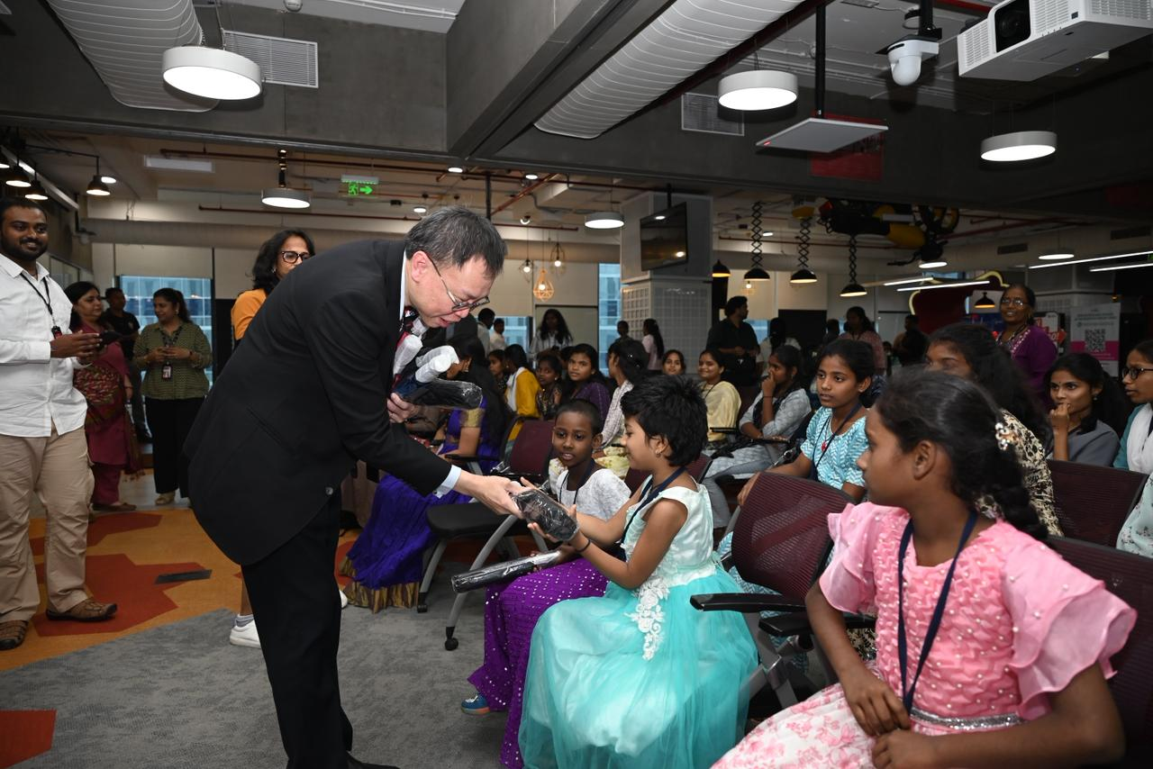
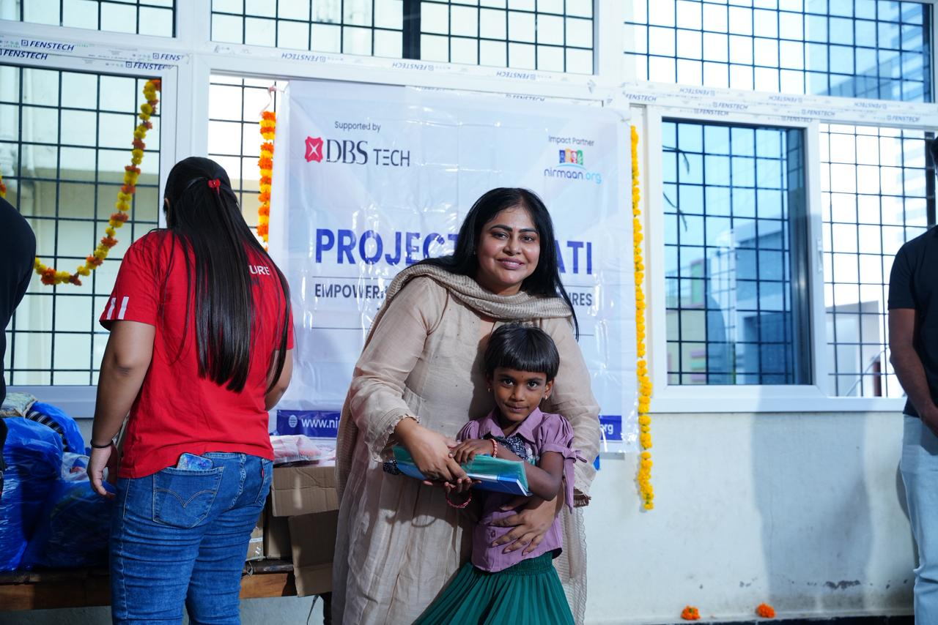
Rural / Community Development
Stronger Communities. Shared Responsibility.
Objective:
Enable employees to engage directly with local communities, supporting access to education, civic awareness, public spaces, and social wellbeing.
Activities are designed for on-ground engagement with visible, immediate outcomes
18+
Activities
40-70+
Employee Participation
Impact: Entire communities, schools, & neighborhoods
2-5
Estimated Efforts (hours)
Top Volunteering Activities
Transform a Neighbourhood School
Community Clean-up & Engagement Drives
Civic Responsibility & Voter Awareness
Orphanage / Old Age Home Engagement
Budget: ₹ 24,000 - 97,000 / Activity
Note: Budget varies as per the activity, participants and duration

Slide 6
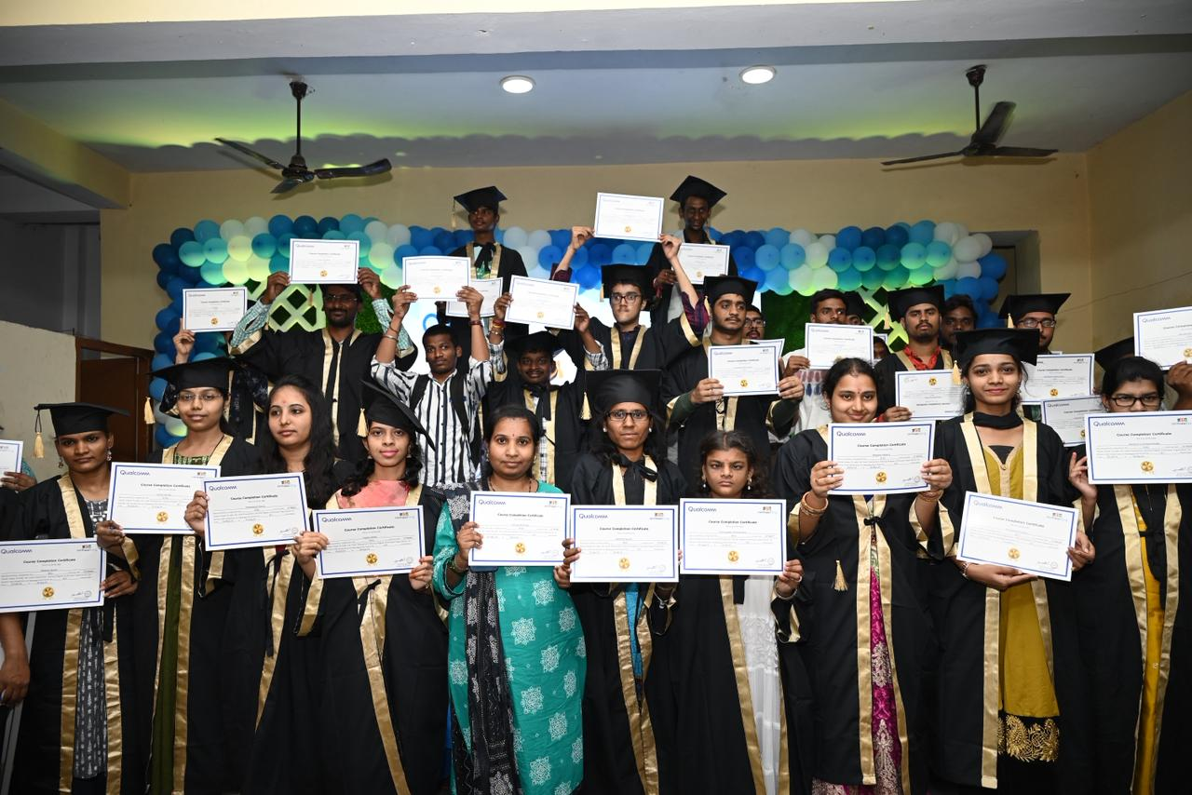
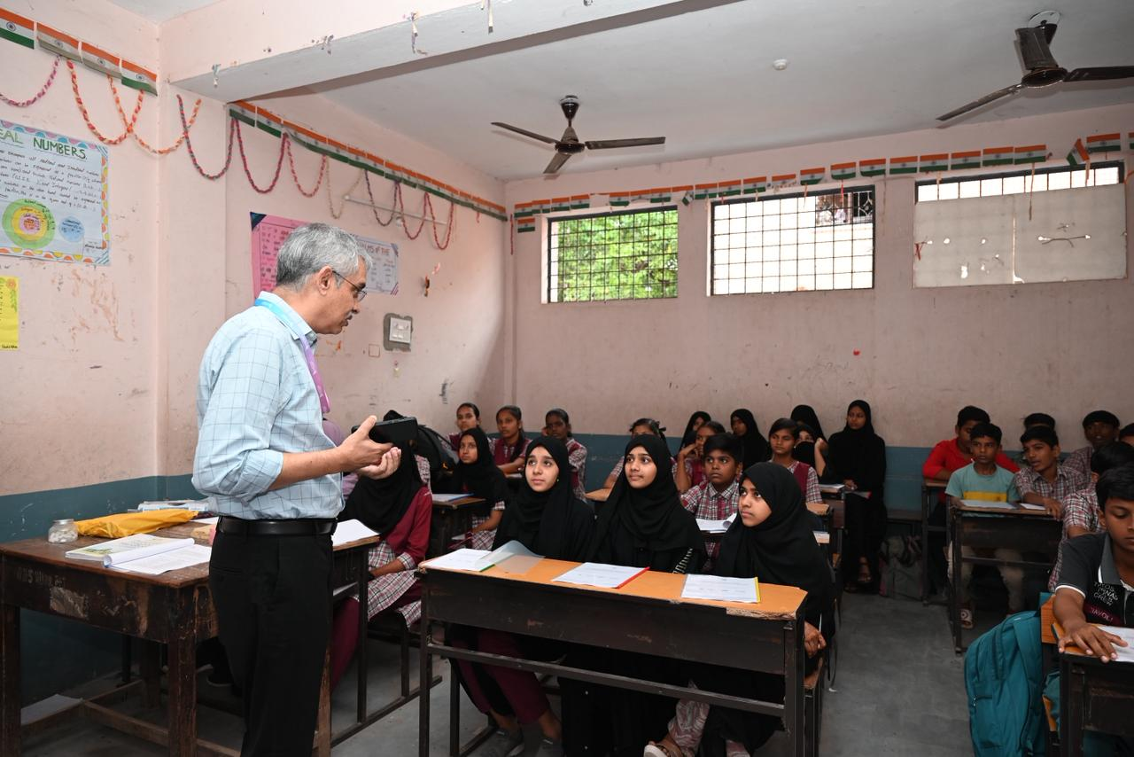
Skill Development & Entrepreneurship
Skills That Enable Livelihoods.
Objective:
Leverage employee expertise to support youth, women, and first-generation learners with practical skills, career exposure, and employment readiness.
Includes short workshops and deep-impact skill programs.
19+
Activities
30-60+
Employee Participation
40-200+
Impact (Students
1-6
Estimated Efforts (hours)
Top Volunteering Activities
One Skill, One Hour – Micro Workshops
Interview Etiquette & Career Readiness Sessions
Digital Literacy / Financial Literacy Workshops
Women Return-to-Work Program
Budget: ₹ 17,000 - 70,000 / Activity
Note: Budget varies as per the activity, participants and duration

Slide 7
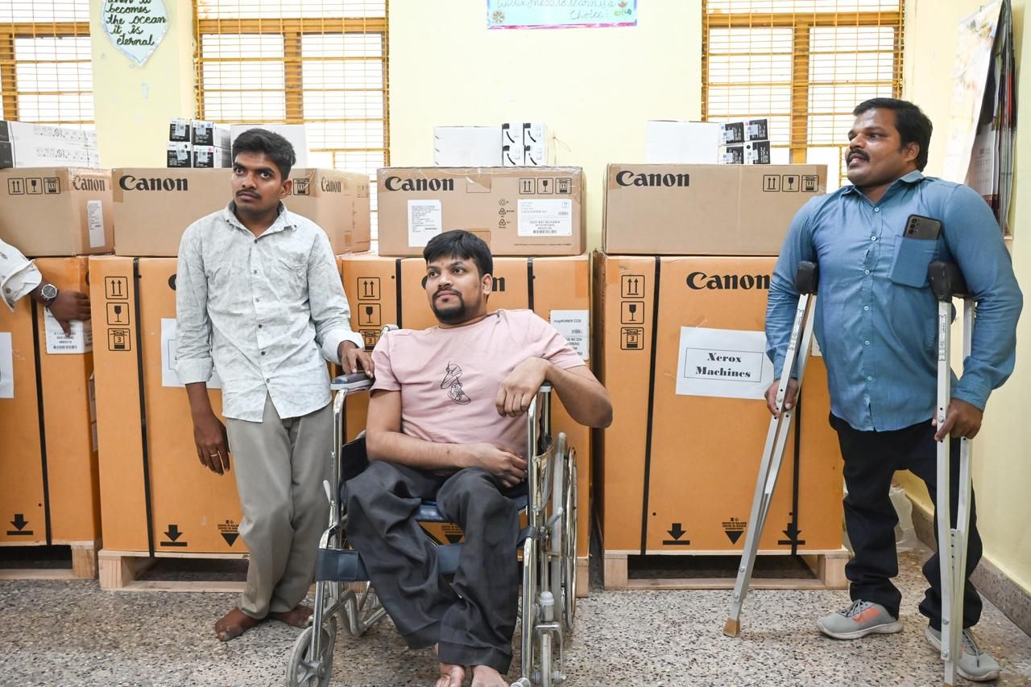
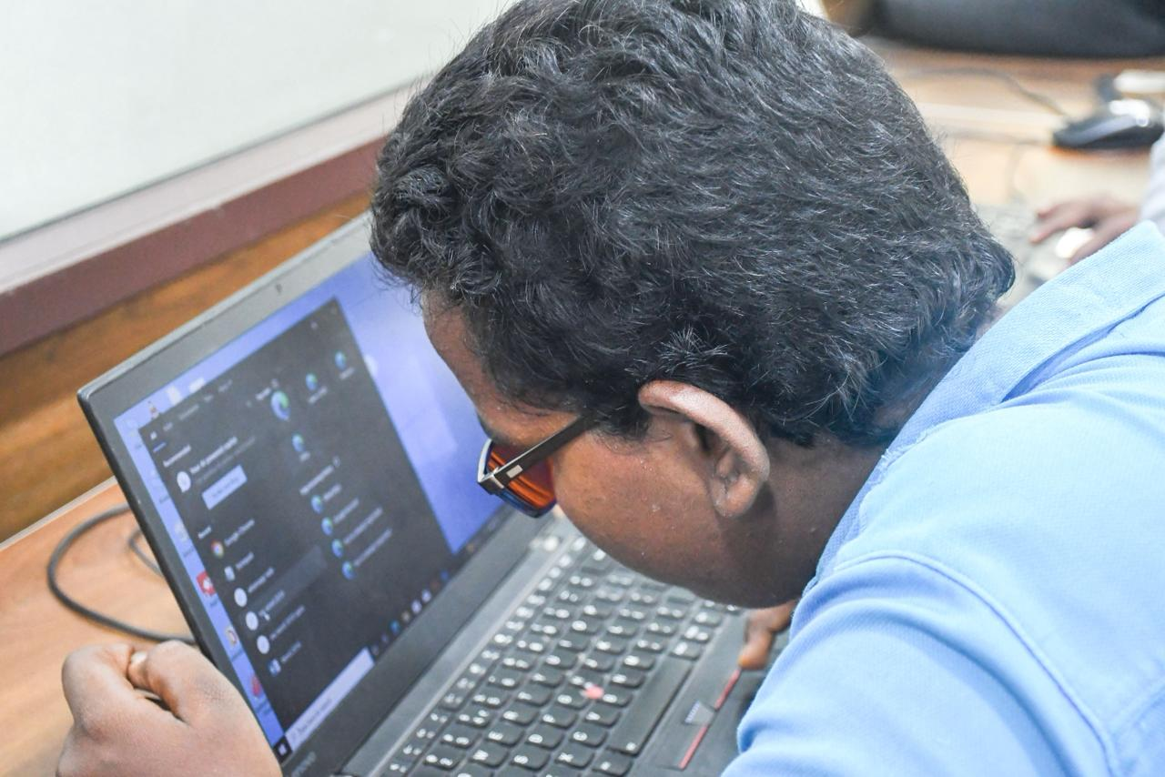
Diversity, Equity & Inclusion (DEI)
Inclusion That Goes Beyond the Workplace
Objective:
Promote empathy, accessibility, and inclusion by engaging employees in DEI-focused volunteering supporting persons with disabilities and marginalized groups.
6
Activities
40-50+
Employee Participation
Targeted, high-depth beneficiary engagement
Avg. Impact (Students
2-3
Estimated Efforts (hours)
Top Volunteering Activities
JAWS Awareness & Demo Session
Audio-Based Games for Blind Children
Braille Literacy Support
Disability Employment Awareness
Budget: ₹ 15000 - 25000 / Activity
Note: Budget varies as per the activity, participants and duration

Slide 8
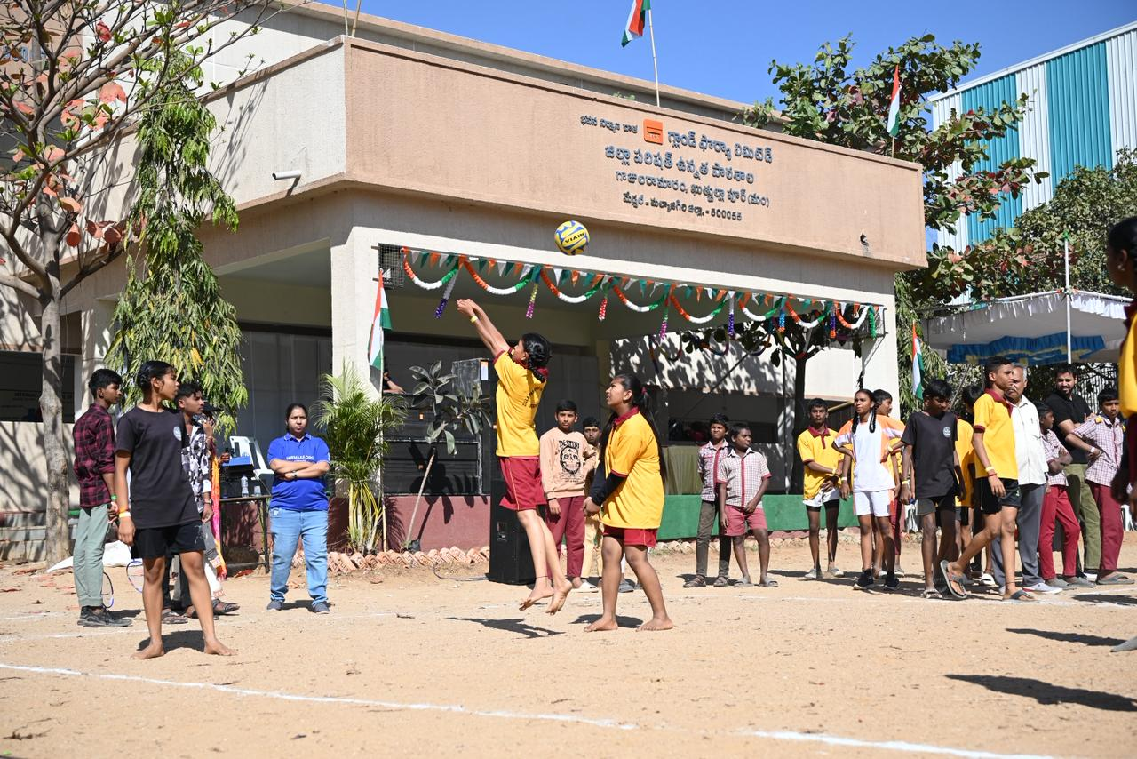
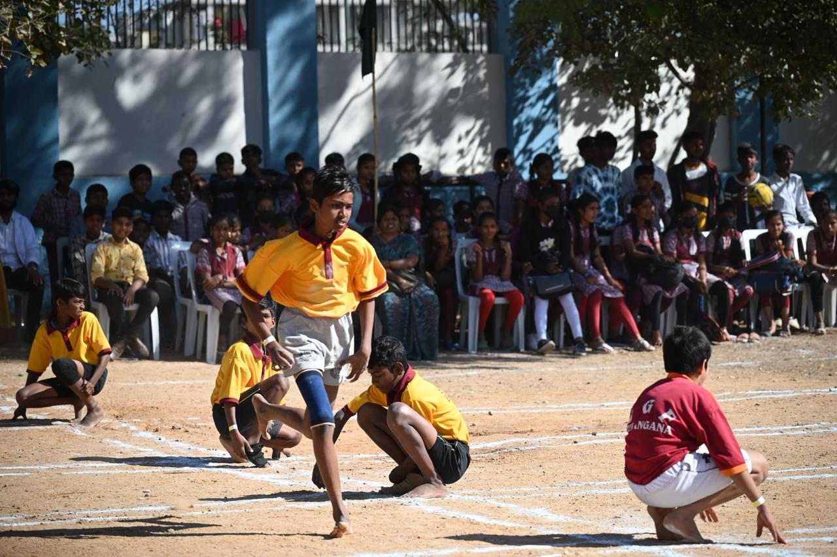
Others (Creative, Engagement-Led Volunteering)
Creativity with Purpose.
Objective:
Offer easy-to-participate, morale-boosting volunteering options that blend creativity, teamwork, and social impact ideal for large corporate participation days.
6
Activities
40-60+
Avg. Employee Participation
Indirect but meaningful beneficiary reach
Avg. Impact
2-3
Estimated Efforts (hours)
Top Volunteering Activities
Canvas Bag / Diya / Candle Painting Drives
Gift Pack Assembly Drive
Community Sports Day
Annual Corporate Impact Showcase
Avg. Budget: ₹ 27000 - 68000 / Activity
Note: Budget varies as per the activity, participants and duration

Slide 9

Volunteering Summary - 2025
Achievement (Calendar Year 2025):
Participating companies: 81 (excluding individuals)
Top 5 contributors: Wells Fargo, DBS Tech, HSBC, Microsoft, PepsiCo
Key Levers
Clear purpose & social impact
Team work
Engaging and motivated volunteers
Skill-based volunteering
impact measurement/feedback
Collaboration required
Corporates and partnerships
Onboarding New Dedicated volunteers
Team work: Education/skill centre
Built an Agile Volunteering Framework/model for Future Nirmaan
55,000+
15,177+
589
1,00,021+
Volunteering Hours
Volunteers
Events
Beneficiaries
Unique Activities by Corporates :
Arcesium One CSR Day
Helping Hand Mela by HSBC
Ration Kit Distribution by Pepsi Co
Tactile Card Event by Wells Fargo
Latkan Making Activity by HSBC

Slide 10

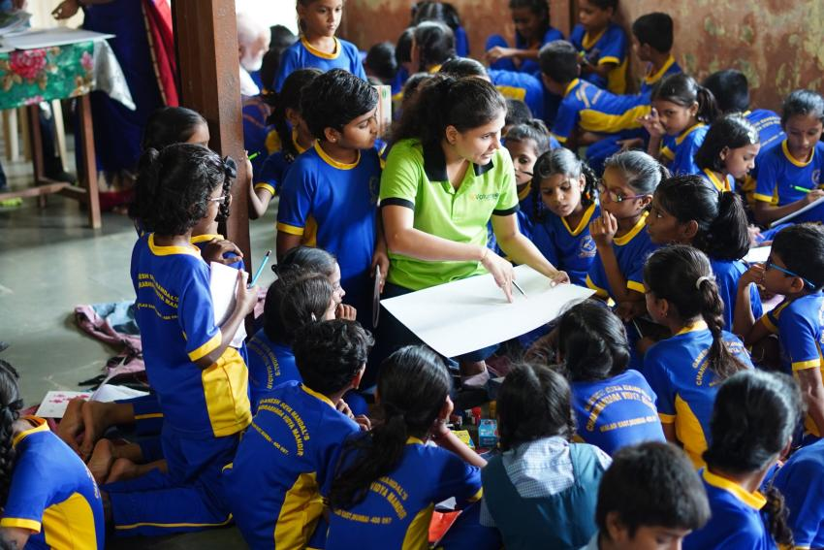
Thank You
We look forward to co-creating meaningful volunteering journeys with your teams.
Scan to explore our Volunteering Calendar 2026
110+ volunteering activities
Multiple causes & time commitments
Easy to align with employee interests & CSR goals
We have only one passion, the rise of a great nation!

